Slide 1






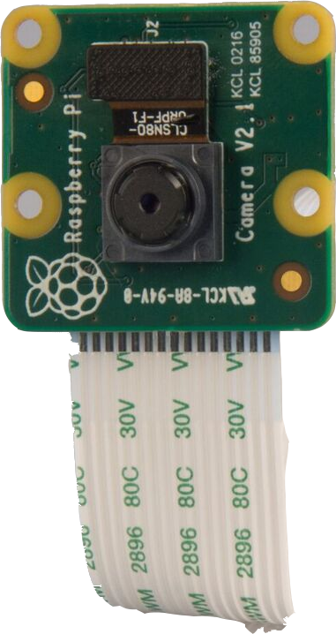



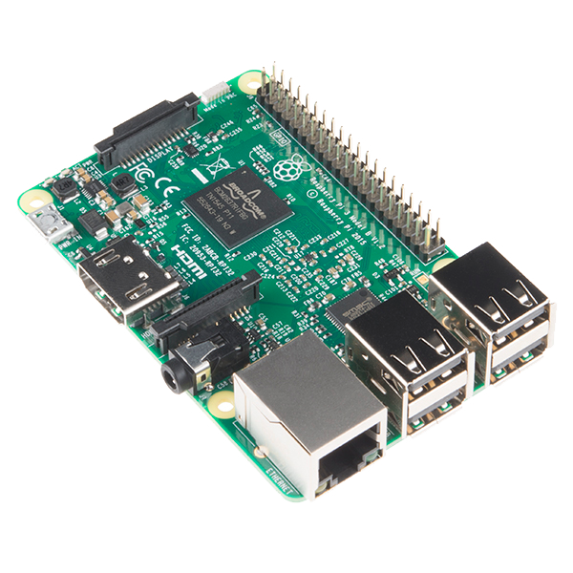

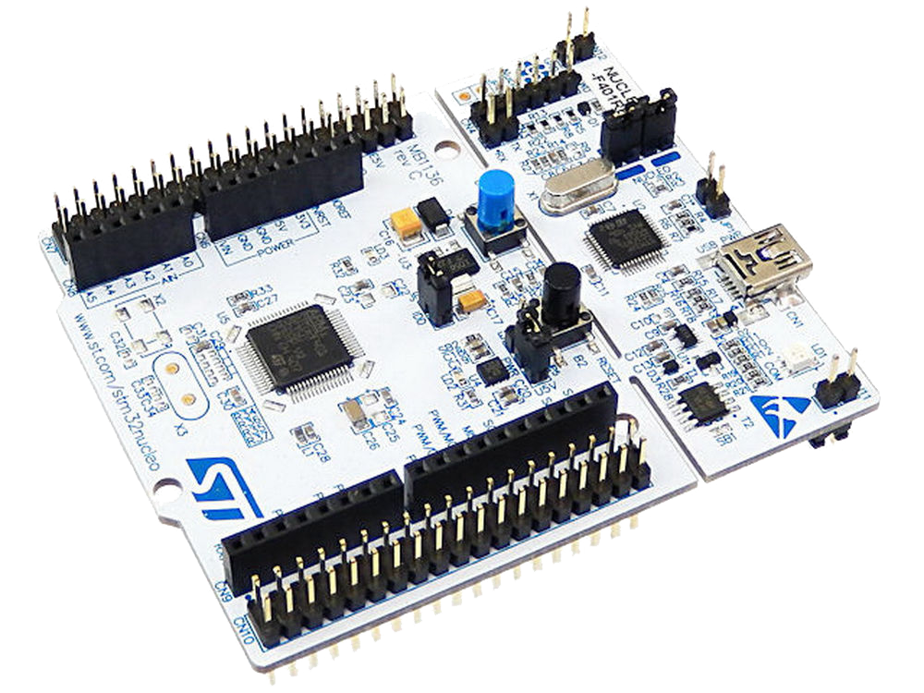

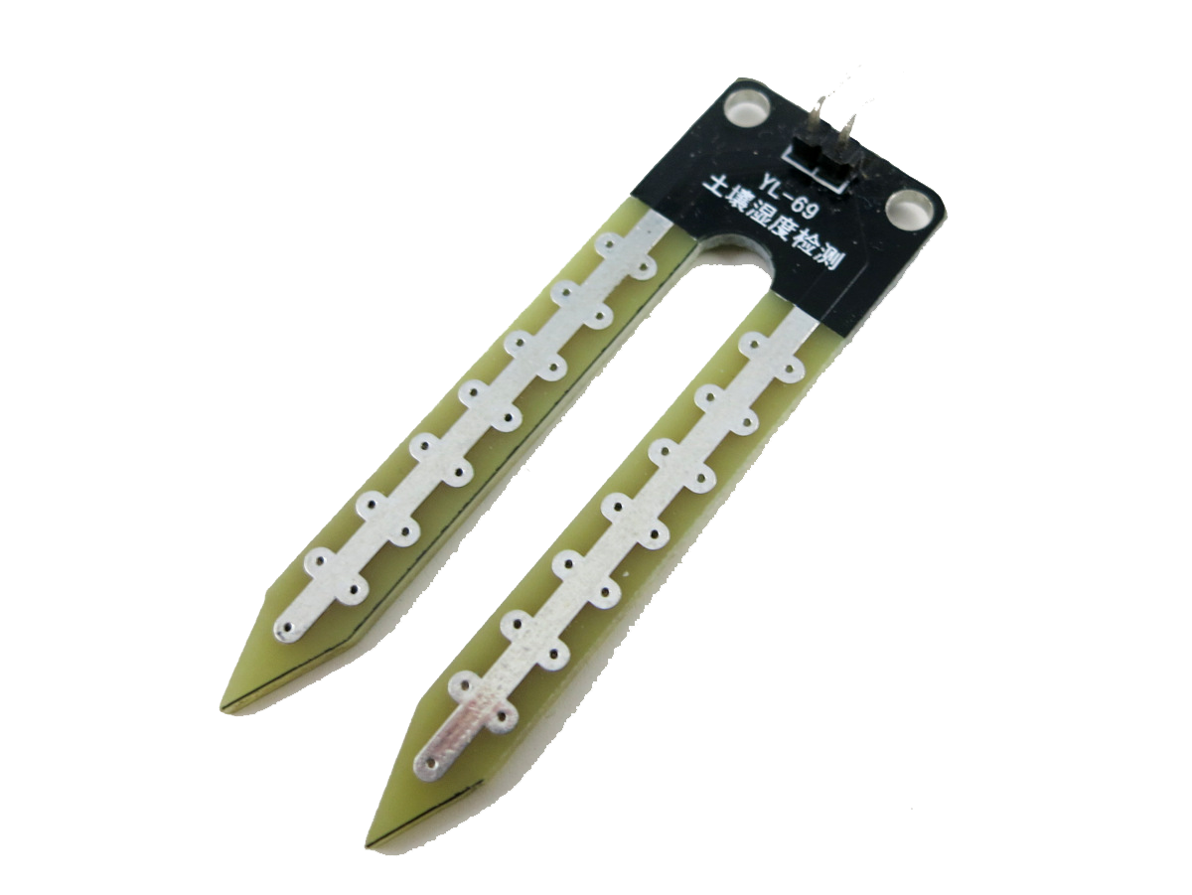





Hoykhom
King Mongkut's Institute of Technology Ladkrabang

Slide 2

Hoykhom
King Mongkut's Institute of Technology Ladkrabang

Slide 3

Hoykhom
King Mongkut's Institute of Technology Ladkrabang

Slide 4

Hoykhom
King Mongkut's Institute of Technology Ladkrabang

Slide 5



Hoykhom
King Mongkut's Institute of Technology Ladkrabang

Slide 6


Slide 7



